Slide 1
The priesthood and you

Slide 2
Hebrews 7:11-17
¹¹ Now if perfection was through the Levitical priesthood (for on the basis of it the people received the Law), what further need was there for another priest to arise according to the order of Melchizedek, and not be designated according to the order of Aaron? ¹² For when the priesthood is changed, of necessity there takes place a change of law also. ¹³ For the one concerning whom these things are spoken belongs to another tribe, from which no one has officiated at the altar. ¹⁴ For it is evident that our Lord was descended from Judah, a tribe with reference to which Moses spoke nothing concerning priests. ¹⁵ And this is clearer still, if another priest arises according to the likeness of Melchizedek,¹⁶ who has become such not on the basis of a law of physical requirement, but according to the power of an indestructible life. ¹⁷ For it is attested of Him,
“You are a priest forever According to the order of Melchizedek.”

Slide 3
Hebrews 7:18-21
¹⁸ For, on the one hand, there is a setting aside of a former commandment because of its weakness and uselessness ¹⁹ (for the Law made nothing perfect), and on the other hand there is a bringing in of a better hope, through which we draw near to God. ²⁰ And inasmuch as it was not without an oath ²¹ (for they indeed became priests without an oath, but He with an oath through the One who said to Him,
“The Lord has sworn And will not change His mind, ‘You are a priest forever’”);

Slide 4
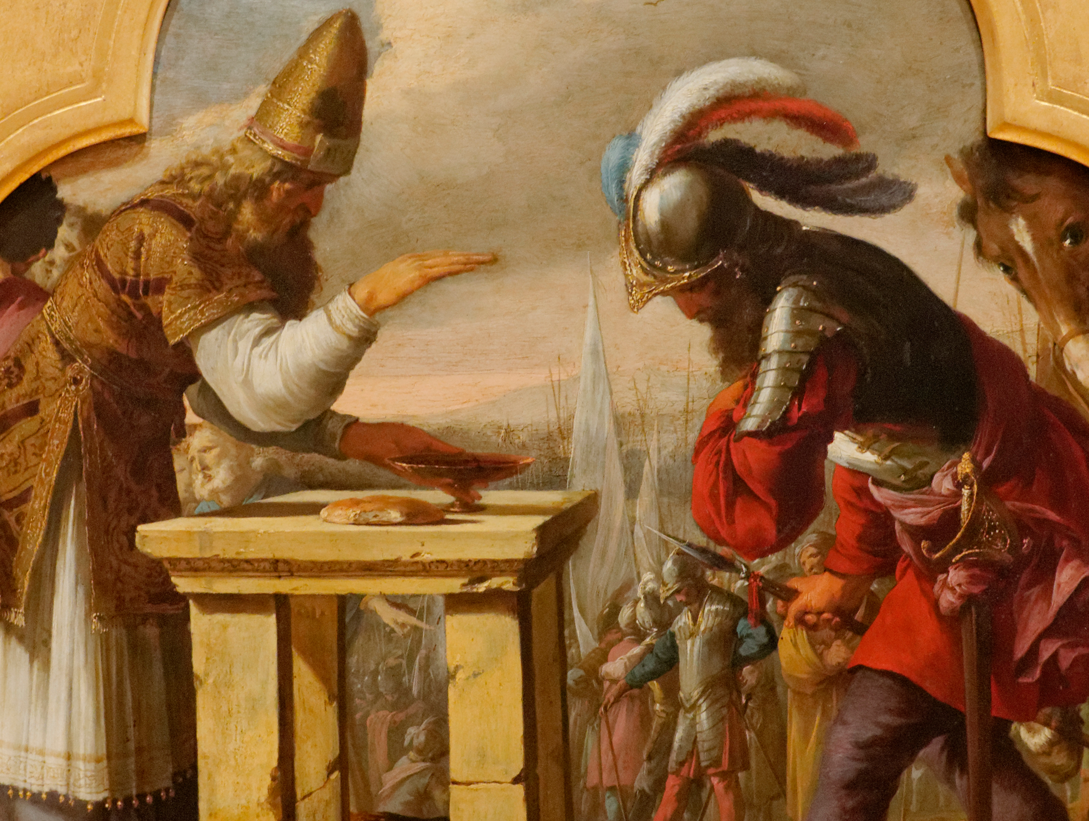

Slide 5
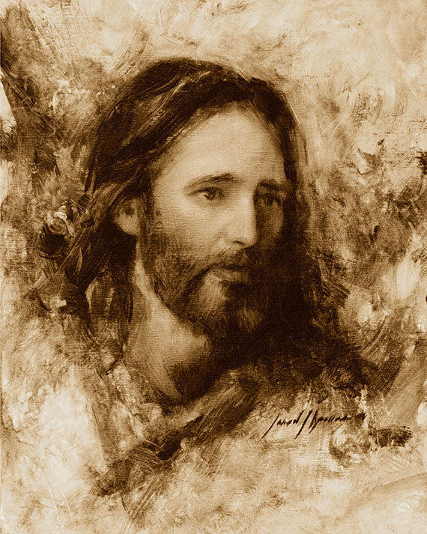

Slide 6
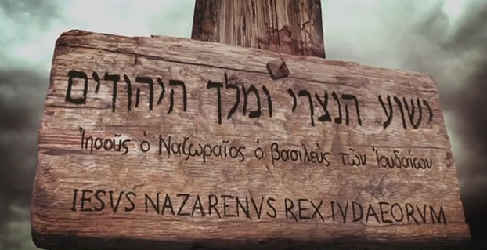

Slide 7
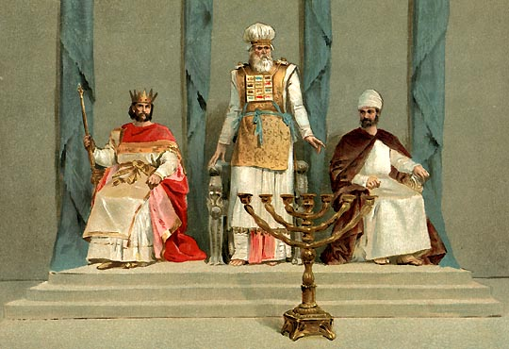
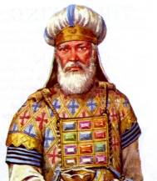
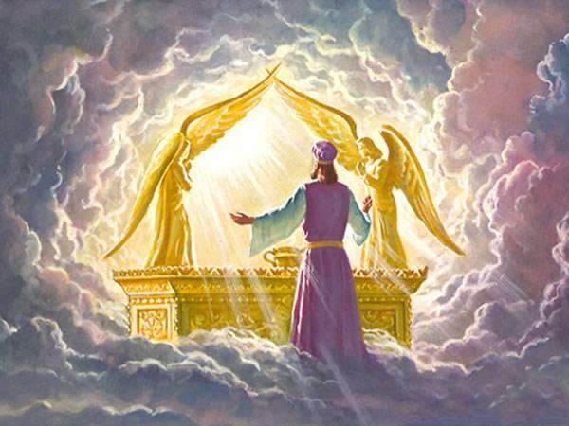
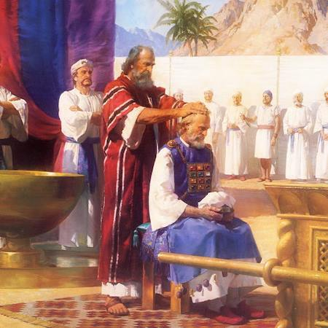
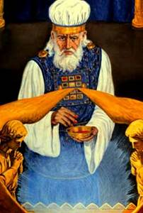

Slide 9
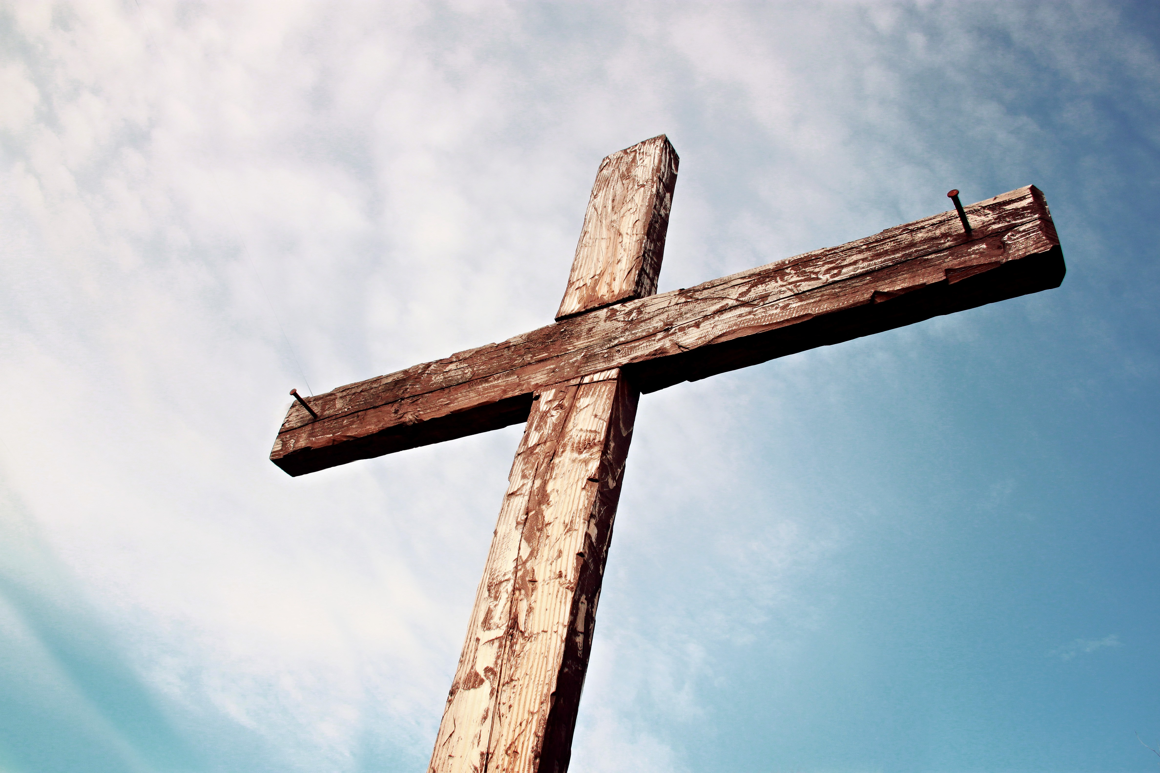

Slide 10
Matthew 2
Luke 2:1-40

Slide 11
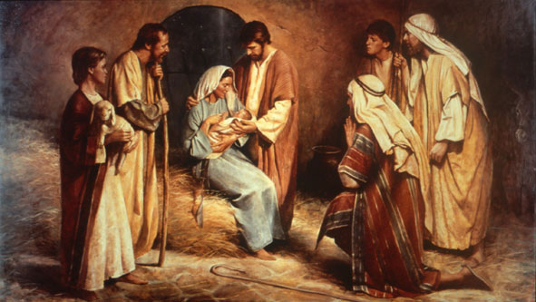
UNTO “US” A CHILD IS BORN
UNTO Who?
Isaiah 9:6:
“For a child will be born to us, a son will be given to us; and the government will rest on His shoulders; and His name will be called Wonderful Counselor, Mighty God, Eternal Father, Prince of Peace.”
וַיִּקְרָא שְׁמֹו פֶּלֶא יֹועֵץ אֵל גִּבֹּור אֲבִיעַד כִּי־יֶלֶד יֻלַּד־לָנוּ בֵּן נִתַּן־לָנוּ וַתְּהִי הַמִּשְׂרָה עַל־שִׁכְמֹו שַׂר־שָׁלֹֽום׃

Slide 12
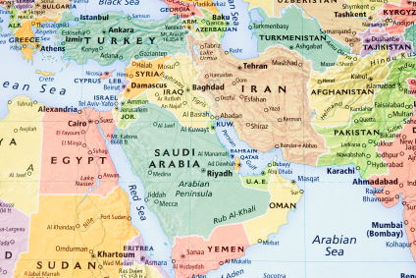
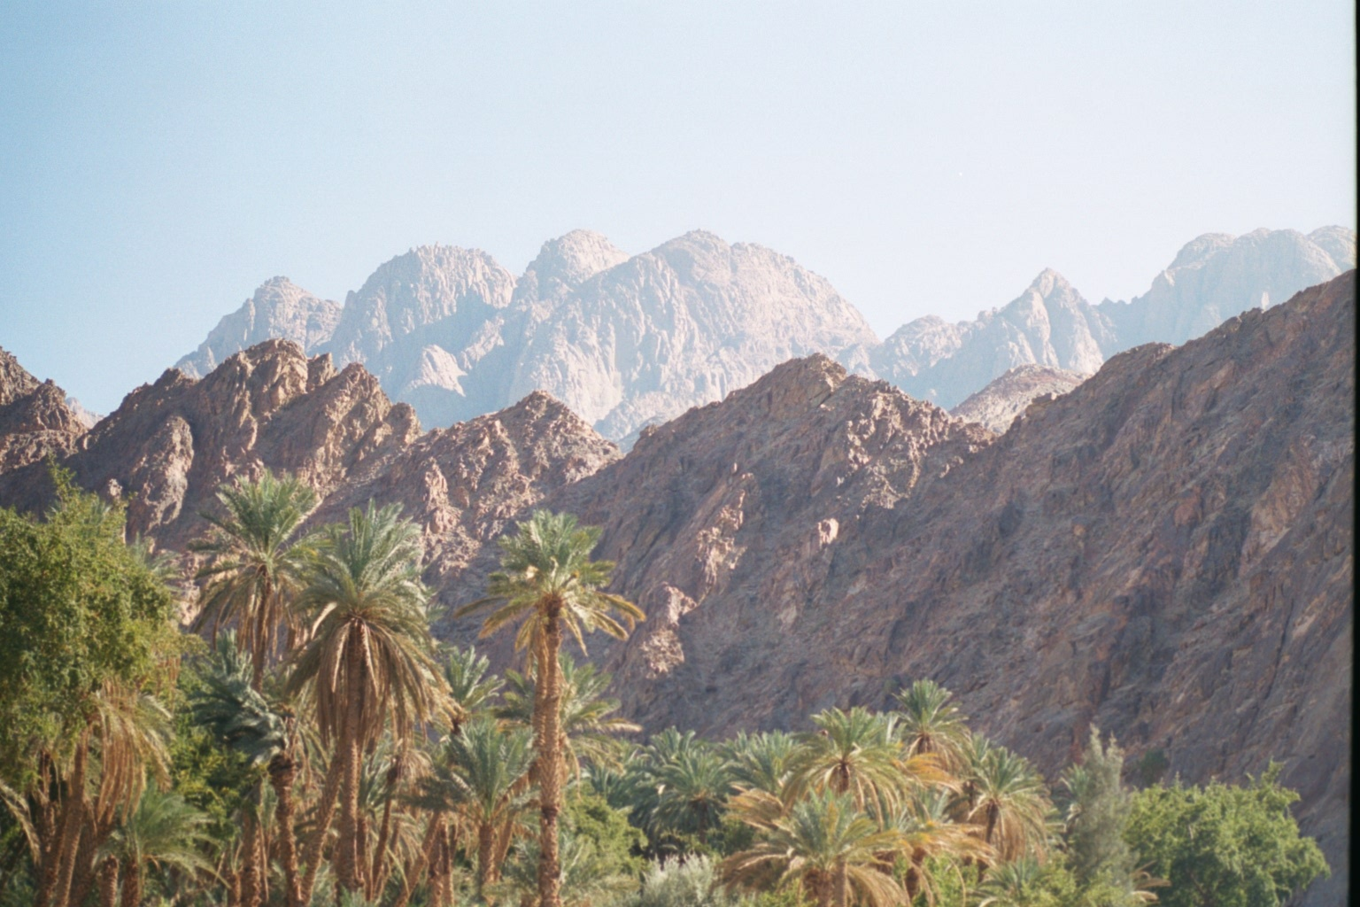
The Journey of Joseph, Mary, and Jesus
The Journey of the wise men from the east
Babylon to Jerusalem:
~550 Miles
Nazareth to Bethlehem: ~ 75 Miles
Tehran to Jerusalem:
~970 Miles
Bethlehem to Jerusalem: ~ 5-10 Miles
We have to add in their trip from Jerusalem to Nazareth as well

Slide 14
timeline
Jesus’ Birth
Flight To Egypt
Jesus’ Return From Egypt
Roman Census
Star’s 2nd Appearance
Star’s 1st Appearance
Herod’s Slaughter /death
Wise men find Jesus
7 BC | 6 BC | 5 BC | 4 BC

Slide 15
